Slide 1




Loan Prediction Project
Name:
Radadiya Darshit
Enroll no:
21002170110146
Branch:
CE-198

Slide 2

Introduction to Loan Prediction Project
We developed a loan prediction project utilizing machine learning. The project leverages Kaggle data to predict loan approval. Our approach includes data preprocessing, cleaning, and visualizations.

Slide 3

Overview of Machine Learning
Data Analysis
Algorithm Selection
Model Training
Understanding and analyzing data trends and patterns is crucial for model building in machine learning.
We explore various machine learning algorithms, including logistic regression, random forest, and decision tree.
Training and evaluating machine learning models are fundamental aspects of the process.

Slide 4
Explanation of Kaggle Data
1
Data Sources
2
Data Quality
3
Feature Sets
The Kaggle dataset provides diverse sources for training and testing loan prediction models.
Evaluating and ensuring data quality is crucial for the success of the machine learning model.
Defining and analyzing different feature sets within the Kaggle data is essential for predictive modeling.

Slide 5

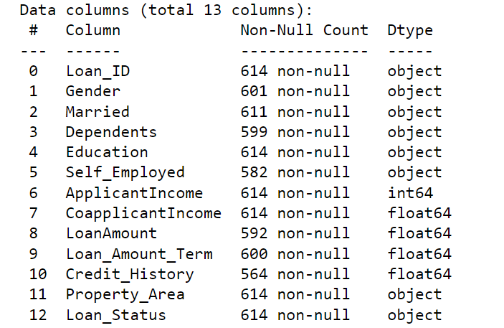
Our Data
In our dataset, we have 13 columns including loan_id, gender, married, dependents, education, self_employed, applicationincome, and loan_amount and etc. There are a total of 614 data points.
Some data are not null and type of data are int , float , object

Slide 6

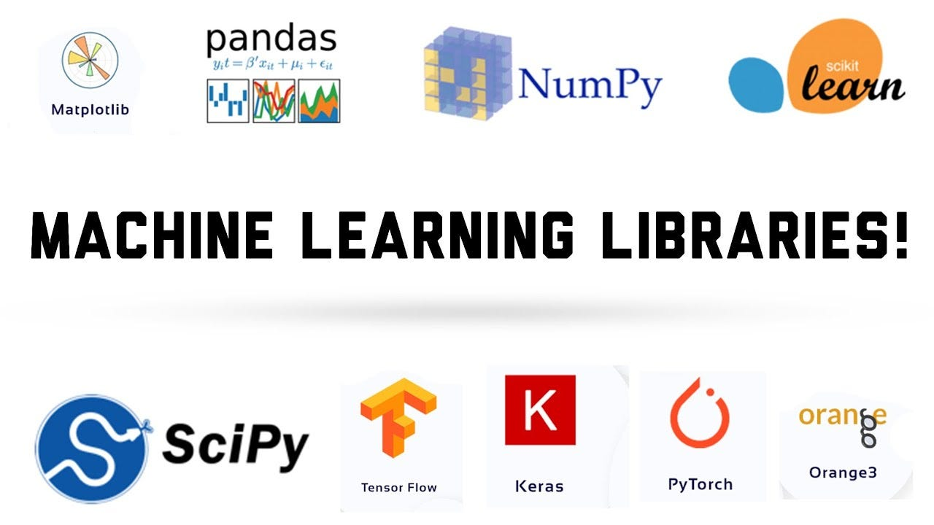
Key Libraries in our Project
Our project leverages various libraries to enhance data analysis and visualization.
We rely on numpy and pandas for data manipulation, sklearn for machine learning ,matplotlib for plotting, and seaborn for creating visually appealing and informative visualizations.

Slide 7
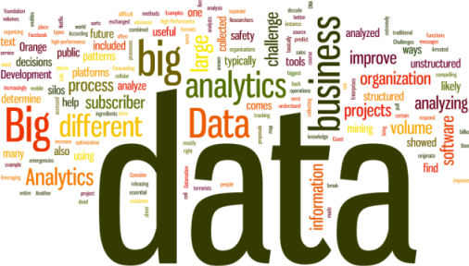
Data Preprocessing Techniques
Preparing data for machine learning models involves handling missing values and removing irrelevant columns.
To address missing values, we can use techniques such as filling with mean, median, or mode. Additionally, we'll identify and drop columns that do not contribute to the predictive modeling process.

Slide 8
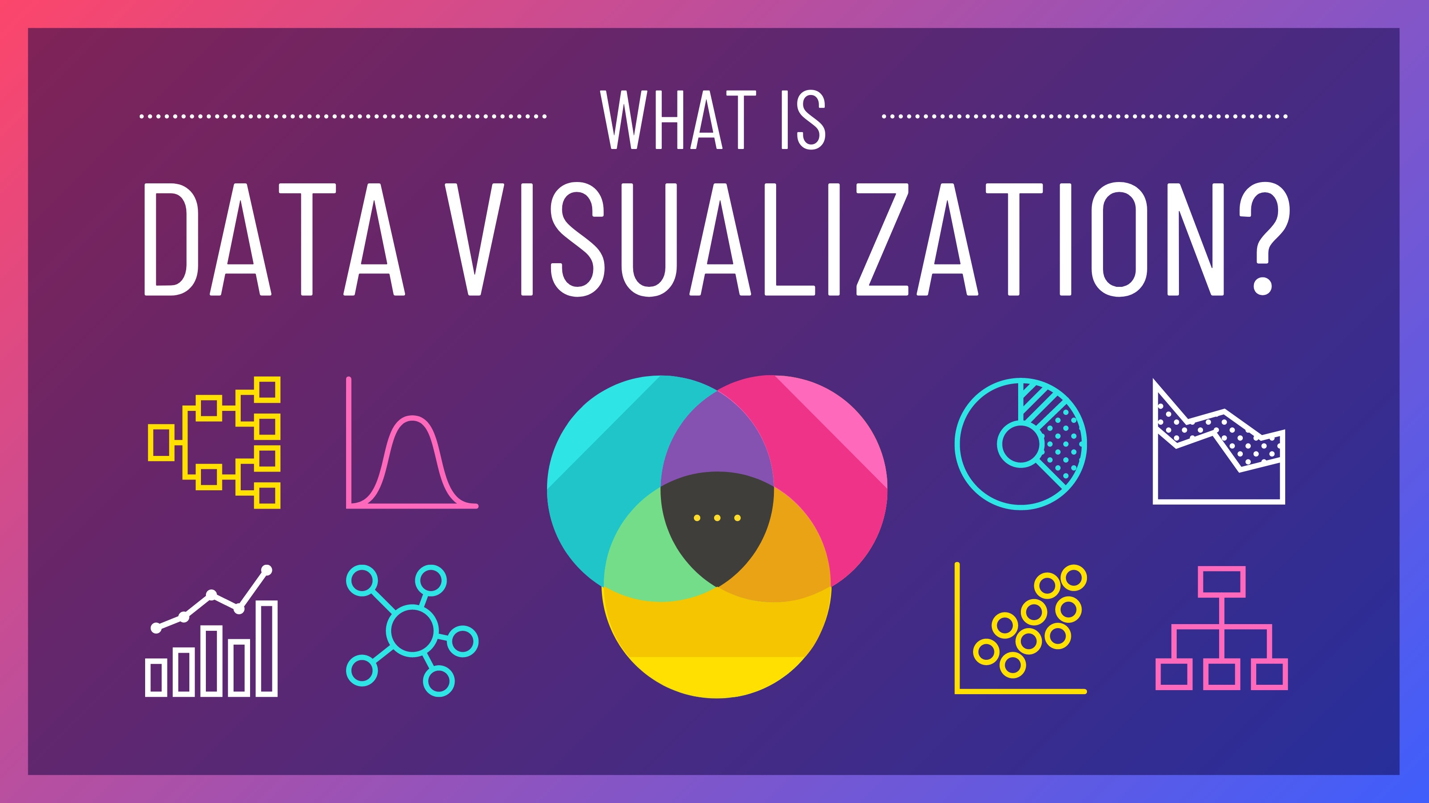
Data Visualization Techniques
Data visualization is a powerful tool for understanding complex datasets. In this card, we'll explore various techniques such as scatter plots, bar charts, and many more visualize the Kaggle dataset and gain valuable insights.
When it comes to visualizing complex datasets, there are many techniques available beyond the basics. In this card, we'll explore advanced techniques such as count plots, histograms, heatmaps, and box plots, and discuss how to use them effectively.

Slide 9
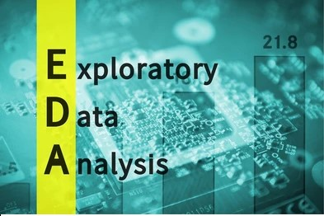
Exploratory Data Analysis
Exploratory Data Analysis (EDA) is a crucial step in the data science process. It involves analyzing and visualizing data to gain insights and understand patterns.
By performing EDA on the Kaggle dataset, we can uncover hidden relationships and make informed decisions for our predictive modeling.

Slide 10

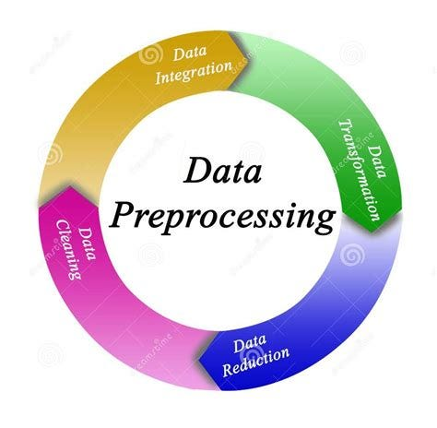



Data Preprocessing and Cleaning
Data Cleaning
Removing or correcting inaccurate data points is a vital part of the preprocessing phase.
LabelEncoder
LabelEncoder is used to transform categorical class labels into numerical labels for machine learning models
Visualization
Visual representations of data trends aid in identifying and handling outliers and inconsistencies.

Slide 11

Feature Engineering
Feature Selection
Dimensionality Reduction
Identifying the most predictive features has a significant impact on the performance of the model.
Reducing the number of features while retaining relevant information is a key phase in feature engineering.
Transformations
Converting raw data into a format suitable for model training is a crucial aspect of feature engineering.

Slide 12

Model Selection and Evaluation
We use all of the above machine learning models to predict values and find accuracy scores and confusion matrices. Based on these metrics, we choose the best model for our data.
Additionally, we evaluate the performance of each model by analyzing various evaluation metrics such as precision, recall, and F1 score.

Slide 13
Model Training and Evaluation
1
Model Training
Training machine learning models with the Kaggle data to predict loan
approvals.
2
Model Evaluation
Evaluating the performance and accuracy of the trained models through testing and validation.

Slide 14
Performance Metrics for Loan Prediction
Accuracy
Precision
Accuracy
Precision
Determining the overall accuracy of the loan prediction models is essential for assessing their efficacy.
Assessing the precision of loan prediction models to minimize false positives is crucial for the financial industry.

Slide 15
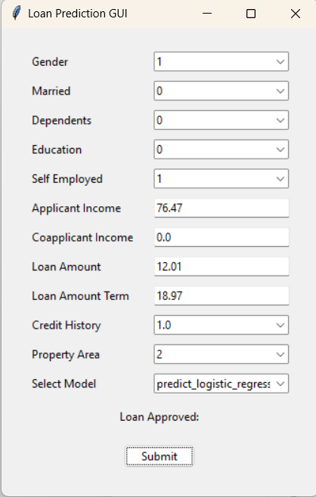


s
Tkinter for User Input
User Input
Loan Approval
Collecting user data through a friendly and interactive interface using Tkinter.
Providing clear and immediate feedback on the approval status of a loan application.

Slide 16
Thank You

